Slide 1
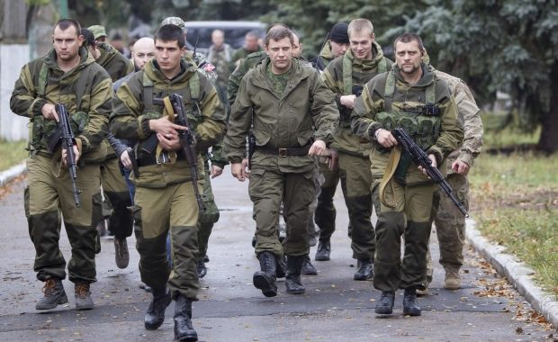
Time, Power, and Principal-Agent Problems:
Why the U.S. Army is Ill-Suited for Proxy Warfare Hotspots
Amos C. Fox
September 20, 2019
“Unless you understand the actual circumstances of war, its nature, and its relations to other things, you will not know the laws of war, or know how to direct war, or be able to win victory.”
- Mao Tse-tung Problems of Strategy in China’s Revolutionary War

Slide 2
Agenda
Argument
Why Understanding Proxy War Matters - Now
Why Understanding Proxy War Matters – Future
U.S. Doctrine Review
Proxyism – A Taxonomy
Understanding the Proxy Environment
The Tyranny of Time
Power
Principal-Agent Problems
The Exploitative Model
The Transactional Model
Understanding the Proxy Environment – an update
Principles for Proxy War
Conclusion

Slide 3
Argument
The U.S. Army is ill-suited for warfare in the proxy environment because:
It does not understand that it and its proxy’s interests wane over time.
It mismanages the fixed time it possesses over a proxy (political and military).
It does not understand the finite power it possesses over a proxy (political and military).
It does not have a taxonomy for proxy war:
Theory of proxy environments (basic theoretical framework)
Theory of proxy war (political and strategic framework)
Doctrine for proxy warfare (operational and tactical)
Existing language obfuscates proxy relationships
Power dynamic
Principal-Agent dynamic
Existing language equates proxy wars with counterinsurgent or security force assistance

Slide 4
Why This Matters:
Proxy Wars Dominate Contemporary War
Principal | Proxy | Conflict | Date
Iran | Hezbollah | Multiple | 1980s-present
United States | Iraqi Security Forces | Operation Inherent Resolve | October 2014-May 2018
United States | Syrian Democratic Forces | Operation Inherent Resolve | October 2014-present
Russia | Syrian Regime Forces | Syrian Civil War | October 2014-present
Russia | Various proxies | Operation Inherent Resolve | October 2014-present
Iran | Shia Militia Groups | Operation Inherent Resolve | October 2014-present
Iran | Houthi Rebels | Yemen Civil War | Spring 2015-present
United States | Filipino Defense Forces | Defeat ISIS campaign | Fall 2016-present
Russia | Separatists | Russo-Ukrainian War | Spring 2014-present
United States | Iraqi Security Forces | Operation Iraqi Freedom / New Dawn | March 2003-December 2011
United States | Afghan Defense Forces | Operation Enduring Freedom / Freedom Sentinel | October 2001-present
Russia | Taliban | Operation Enduring Freedom / Freedom Sentinel | Unknown-present
Russia | Chechen forces (regular and irregular) | Multiple: Russo-Ukrainian War, Op Iraqi Freedom, Op Inherent Resolve, Op Enduring Freedom | 2001-present

Slide 5
Proxy Wars Dominate Contemporary War
U.S. European Command (EUCOM), Posture Statement, March 2019:
“Russia pursues its strategic objectives in Europe, while avoiding direct military conflict with the U.S. and NATO, by targeting countries through indirect action – backed up by the coercive threat of its conventional and nuclear forces. Such actions include…utilizing proxies or armed civilians, such as private military contracting companies with opaque ties to the state.”
“In the Levant, Israel faces a complex set of security challenges from numerous actors across multiple domains. Israel must constantly defend itself from threats posed by Hamas, Lebanese Hezbollah, and Iran, which has expanded its network of proxies…throughout the Middle East.”
U.S. Central Command (CENTCOM), Posture Statement, February 2019:
“If the major actors and their proxies become embroiled in a competition for influence in Syria, this may create space for ISIS remnants or other terrorist groups to reform or reconstitute.”
“To conceal its culpability, the Iranian regime masks its malign activities through proxies and surrogates enabled by the Iran Threat Network (ITN) in Yemen, Syria, Iraq, and Lebanon”
“The conflict in Yemen opened opportunities for Iran, which continues to provide support to the Houthis aimed at building a proxy force designed to pressure the SLC and expand Iranian regional influence.”
U.S. Indo-Pacific Command (INDOPACOM), SASC Opening Statement, February 2019:
“Terrorism and other non-state actors also pose threats to our vision of a Free and Open Indo-Pacific…as evidenced in 2017 when ISIS captured the Southern Philippines city of Marawi – a city of more than 200,000 people.”

Slide 6
Proxy Wars Dominate Contemporary War
U.S. Special Operations Command (SOCOM), HASC Testimony on Emerging Threats, February 2018:
“Iran took advantage of regional instability to expand its influence through partners and proxies…To counter these efforts Special Operations Forces support United States Central Command through a variety of activities in order to degrade Iranian influence…and disrupt their actions.”
“…SOF provides unique options to counter Russia’s use of indirect actions and unconventional warfare…SOF maintains persistent presence and effects in many European countries…”
U.S. Africa Command (AFRICOM), Posture Statement, 2018:
American military forces continue to target al-Shabaab, Boko Haram, Al Qaeda, and the Islamic State in Africa through “Remote or accompanied advise and assist missions”.
U.S. Southern Command (SOUTHCOM), Posture Statement, February 2019:
“Russia and China are expanding their influence in the Western Hemisphere…Both enable —and are enabled by—actions in Venezuela, Nicaragua, and Cuba that threaten hemispheric security and prosperity...”
“It (Iran) has deepened its anti-U.S. influence campaign in Spanish language media, and its proxy Lebanese Hezbollah maintains facilitation networks throughout the region...”

Slide 7
Why This Matters:
Proxy wars will dominate future:
…Because nuclear weapons will continue to inhibit direct great power and regional power competition;
…Because unless a polarizing event occurs, great powers and regional powers will remain politically and domestically unwilling to shoulder the burden of bloody land wars the likes of Mosul, Marawi, Ilovaisk, Zelenopillya, or Donetsk Airport.
Therefore:
…great powers and regional powers will continue to indirectly pursue their self-interests through intermediaries;
….great powers and regional powers will continue to indirectly defend their self-interests through intermediaries;
…the U.S. Army must understand the phenomena of proxy war in order to advance its own cause;
…the U.S. Army must understand the relationship it maintains with a proxy in order to effectively manage the relationship;
…the U.S. Army must understand the phenomena of proxy war in order to disrupt and defeat its opponent’s proxy approach (must understand it to defeat it).

Slide 8
U.S. Doctrine Review
Name | Type of Doctrine | Publication Date | Mentions
National Security Strategy 2017 | National Strategy | December 2017 | 0
National Defense Strategy 2018: Sharpening the American Military’s Competitive Advantage | National Strategy | January 2018 | 1
National Intelligence Strategy 2019 | National Strategy | January 2019 | 0
Joint Doctrine Note 1-19, Competition Continuum | Joint Doctrine | June 2019 | 6
Joint Operating Concept: Irregular Warfare: Countering Irregular Threats | Joint Doctrine | May 2010 | 3
Joint Operating Environment: The Joint Force in a Contested and Disordered World | Joint Doctrine | July 2016 | 11
JP 3-0, Operations | Joint Doctrine | October 2018 | 1
JP 3-05, Special Operations | Joint Doctrine | July 2014 | 0
JP 3-20, Security Cooperation | Joint Doctrine | May 2017 | 0
JP 3-22, Foreign Internal Defense | Joint Doctrine | August 2018 | 1
FM 3-05, Army Special Operations | Special Forces | January 2014 | 2
ATP 3-05.1, Unconventional Warfare | Special Forces | September 2013 | 1
FM 3-0, Operations | Conventional Army | October 2017 | 0
ATP 3-05.20, Special Operations Intelligence | Special Forces | May 2013 | 0
ATP 3-96.1, Security Force Assistance Brigade | Conventional Army | May 2018 | 0
ATP 3-07.10, Stability Techniques | Special Forces | August 2012 | 0
ATP 3-18.1, Special Forces Unconventional Warfare | Special Forces | March 2019 | 1
TC 7-100, Hybrid Threat | Training Environment | November 2010 | 2
TC 7-100.2, Opposing Force Tactics | Training Environment | December 2011 | 0
TC 7-100.3, Irregular Opposing Forces | Training Environment | January 2014 | 0
TC 7-100.4, Hybrid Threat Force Structure Organizational Guide | Training Environment | June 2015 | 0
TC 7-102, Operational Environment and Army Learning | Training Environment | November 2014 | 0

Slide 9
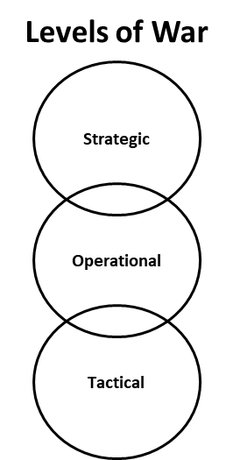
Proxyism: A Taxonomy
Proxyism
Comprehensive Theory
Proxy Environment
Political and Strategic Space
Proxy War
Strategic and Operational Space
Proxy Warfare
Operational and Tactical Space

Slide 10
Defining the Proxy Environment
Proxy environments are governed by the interplay of:
Time
Power Dynamics
Principal-Agent Dynamic

Slide 11
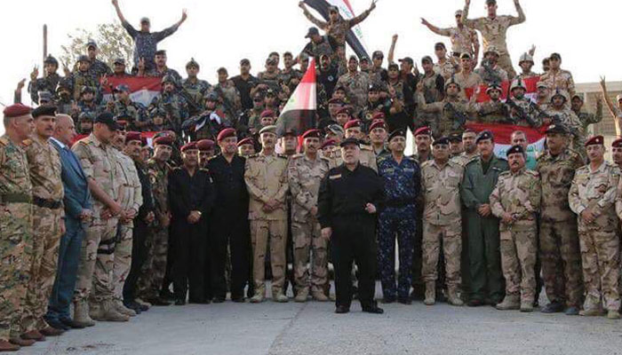
The Tyranny of Time
Principal and agents’ shifting political winds result in proxy environments being dominated by a running clock.
Time operates at different rates across the levels of war, as well as the social and political spectrum for each participant.
Social and political clocks churn quicker than military clocks – politicians and societies, especially those feeling the effect of the conflict, pine for victory at a faster rate than military leaders.
Commanders must understand that the clock they want to operate on is less relevant than that of their political leaders and those of their proxy agents.
Commanders must balance the time being kept on all these clocks.
Commanders must be tuned to the social and political appetites of their proxies, especially in transactional relationships; they can turn the relationship foul.

Slide 12
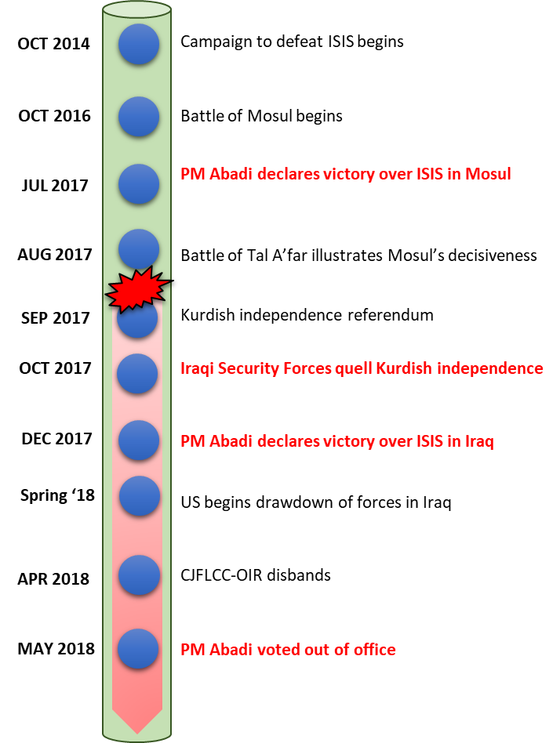
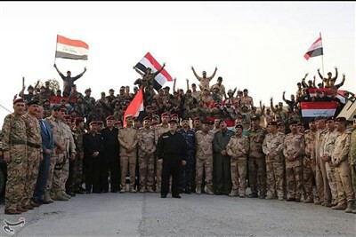
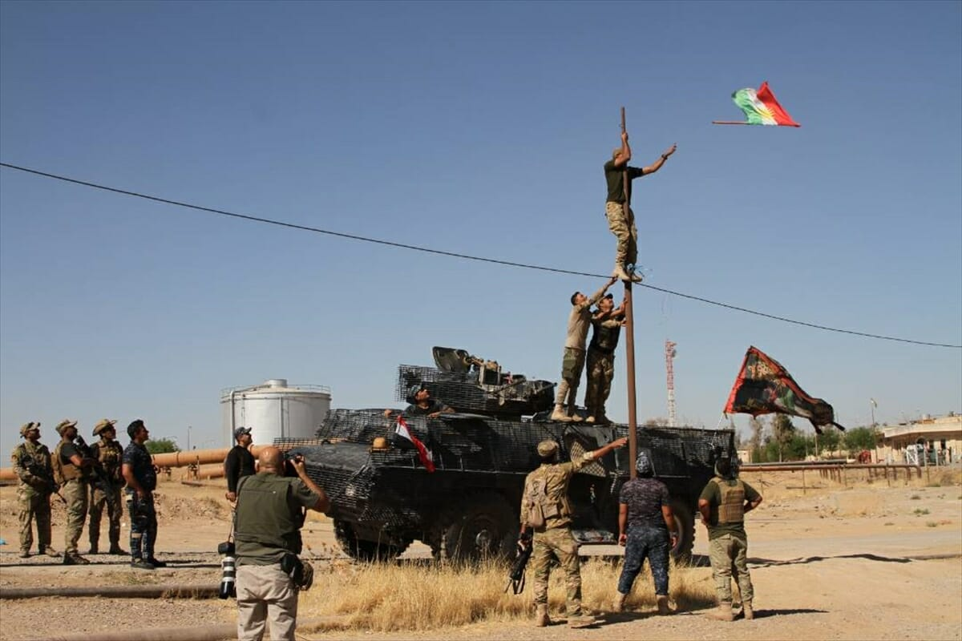
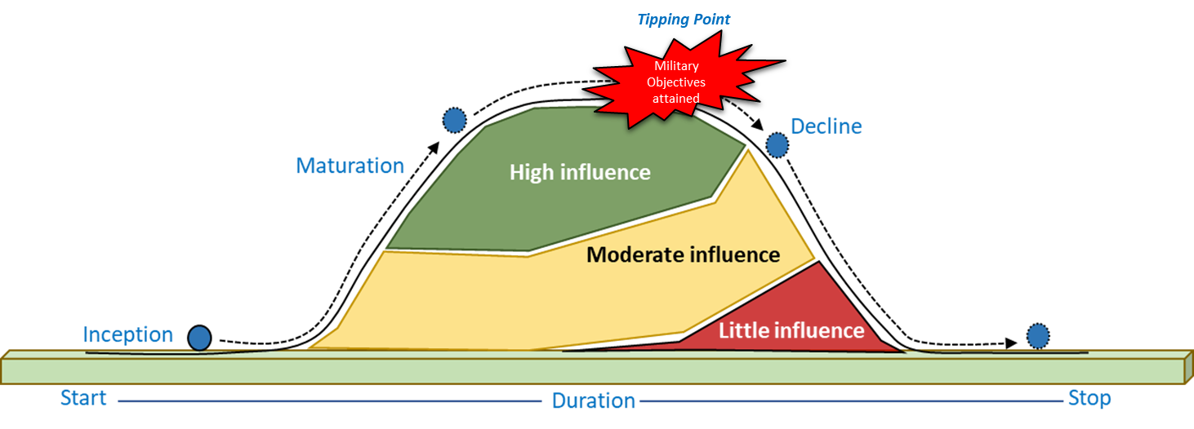
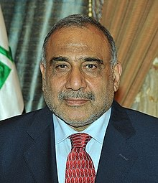
Time’s Effect on Proxy Relationship
PM Abadi declaring victory in Mosul.
Iraqi Security Forces quelling Kurdish independence.
Adil Abdul-Mahdi becomes new Prime Minister

Slide 13
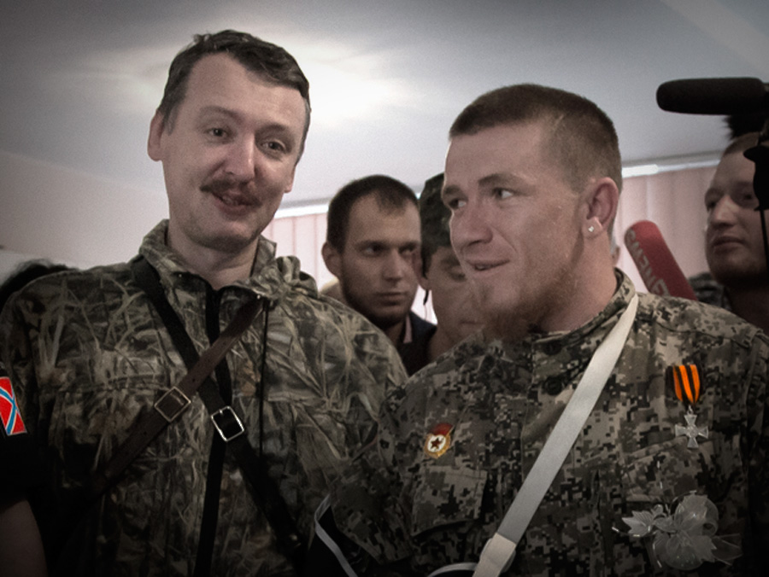
Power
“A has power over B to the extent that he can get B to do something that B would not otherwise do.” – Robert Dahl
A = The principal
B = The agent, or proxy
A relationship or connection must exist between the principal and the proxy for the principal to enact power over the proxy.
Power must have a base and that base requires activation in order to generate a desired effect.
Effectively manipulating that base is the primary means for maintaining power over another actor – can be coercion, soft power, or a melding of the two.
Lag – the delay that exists between A’s exertion of power and B’s ability to react.
Relationships or connections are not static, but evolve as conditions change and other actors enter or depart a given situation.
Dynamic relationships result in increases and decreases in one’s relative power over another.
Dahl’s principles of power, when synthesized with the principal-agent problem and time, for result in two theoretical models of proxy war – exploitative model and the transaction model.
Russian intelligence officer Igor Girkin and Arsen Pavlov, commander of the DPA’s Sparta Battalion

Slide 14
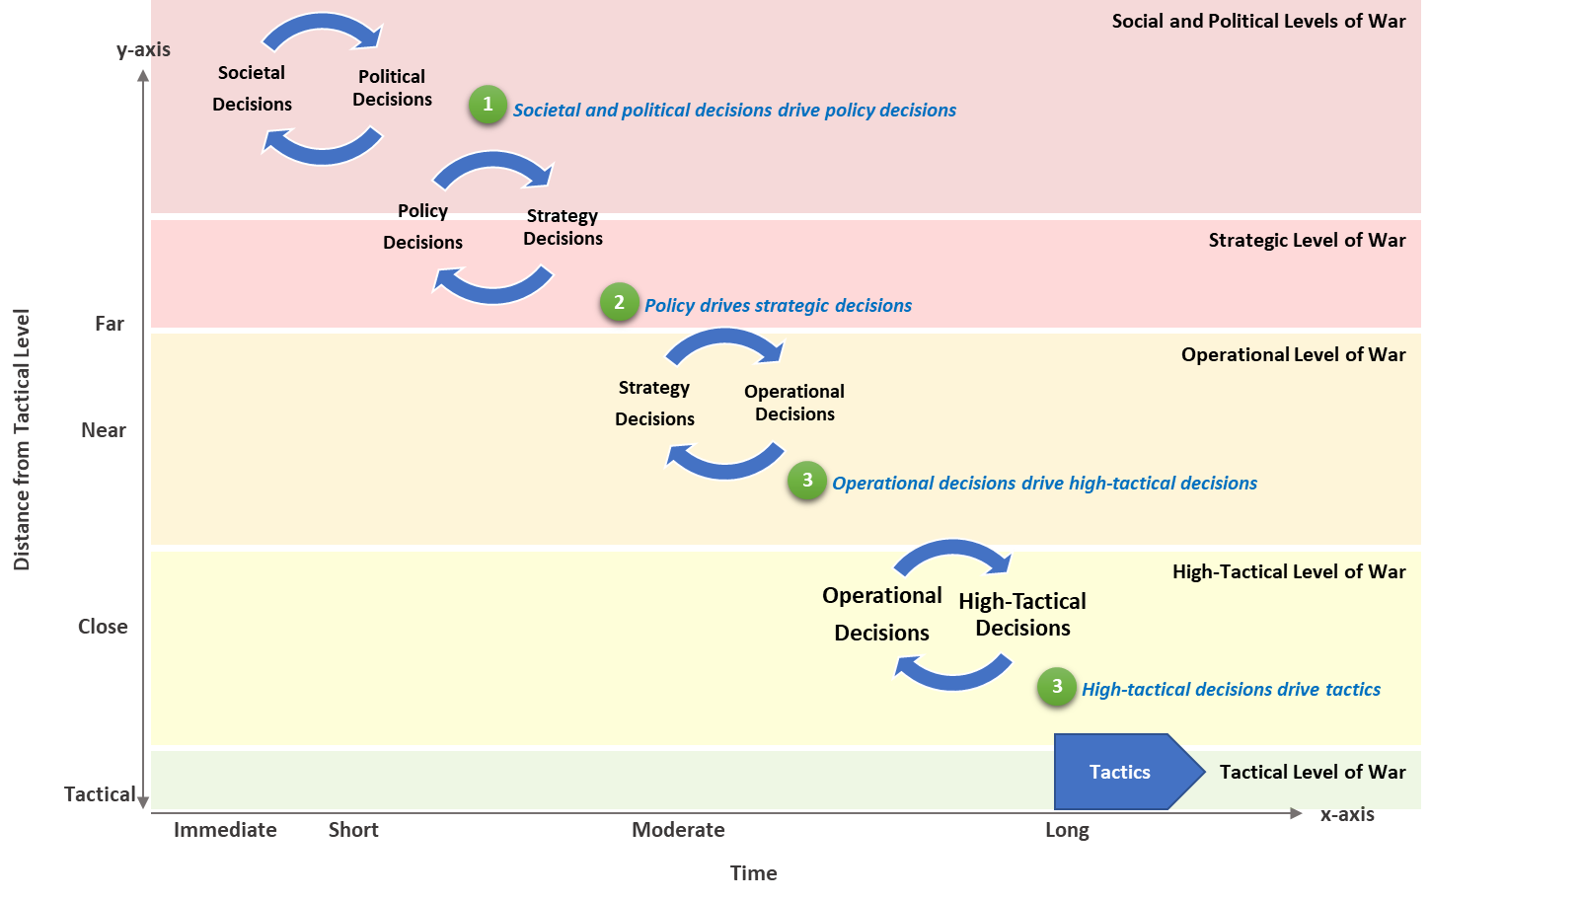
Graphical Representation of “Lag”
“Lag” is why commanders must not rely on ‘bottom up’ refinement but must have a good assessments program.

Slide 15
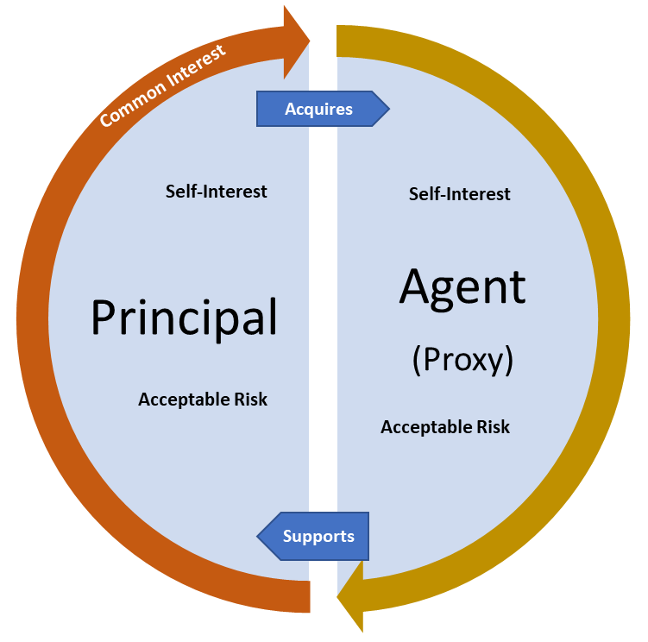
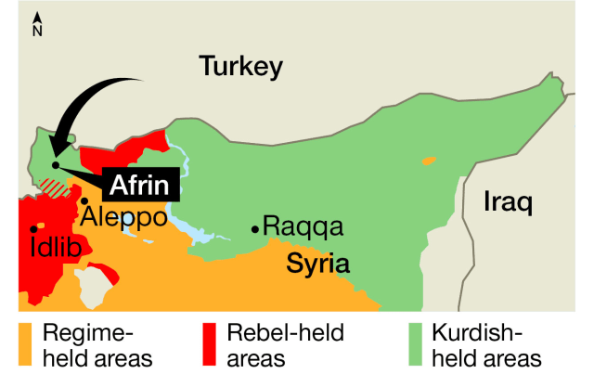
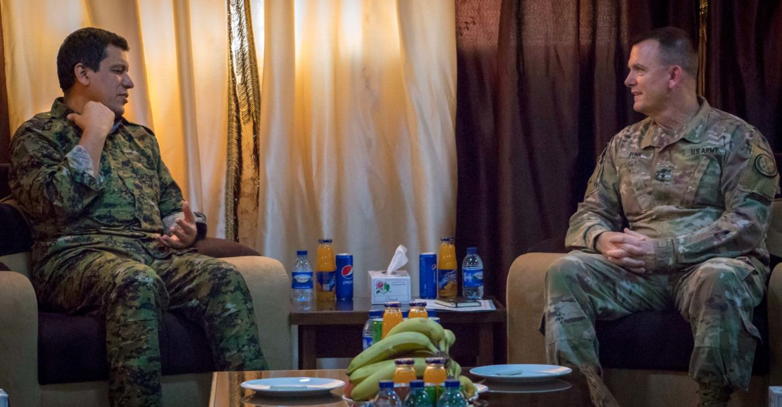
Principal-Agent Problem
Operation Olive Branch
Principal-Agent Problem:
Arises when one party (principal) delegates work to another (agent) who performs the work. – Kathleen Eisenhadt, Stanford University
Problem of agency – goals of the principal and agent conflict
Problem of risk sharing – the principal and agent possessing dissimilar prerogatives toward risk, which results in divergent interests
“One country may support another’s cause, but will never take it so serious as it takes its own.”
- Carl von Clausewitz
On War
Common Interest

Slide 16
Proxy is completely dependent on its principal for survival
Dependency creates a strong bond between the proxy and its principal – results in the principal having almost unlimited power and influence over the proxy
Results in proxy having limited utility for the principal – a tool to accomplish a task
Once the objective is accomplished or the proxy is no longer useful, the principal terminates the relationship
Modern Examples:
Donetsk and Luhansk Peoples Republics and Armies in Ukraine’s Donbas
Syrian Democratic Forces in eastern Syria
Iraqi Security Forces in Operation Iraqi Freedom
Success can drive divergence:
Generate legitimacy or support to gain independence
Emergent actors lure the proxy away from the principal

Slide 17
Proxy Success and the Evolution of Partnered Relationships
Objective
Emergent Partner
Proxy
Objective
Principal
Objectives, conditions, and endstates
evolve as success is achieved and
missions are accomplished and as the
proxy continues to gain strength (often a
byproduct of partner-directed activities).
Campaign
Proxy
SUCCESS ACCELERATES DIVERGENCE
Success brings emergent partners to the proxy force (”always bet on a winner”) as the emergent partner seeks to use the proxy to accomplish its aims or objectives in the proxy’s given area of operation.
Objective
Proxy
Emergent Partner

Slide 18
Hierarchical Structure – Exploitative Model, Russo-Ukrainian War
 | Principal | Proxy
Political | Russian Federation | DPR; LPR
Strategic | Russian Federation; Western and Southern Military Districts | DPR; LPR
Operational | Western and Southern Military Districts; Deployed Russian Army and Corps headquarters | DPA; LPA
Tactical | Russian tactical commands | Separatists battalions

Slide 19
Paradoxical – proxy is the power-broker
Proxy government is not subjugated to the principal – it requires assistance
Results in a transactional relationship between the principal and the proxy
Transactional relationship means the relationship is dominated by a running clock – objectives achieved drive divergence
Transactional relationship results in parameters on the relationship in order to align the principal and proxy
Force caps
Clearly defined mission and timelines
Territorial limitations
Proxy has fixed political and social interest in the principal; dependency will end when objectives met
Extremely vulnerable to external actors, especially as the partners close on achieving their aligned objectives

Slide 20
Hierarchical Structure – Transaction Model, Counter-Islamic State Campaign (Iraq)
 | Principal | Proxy
Political | Ill-defined | Ill-defined
Strategic | Ill-defined | Ill-defined
Operational | Combined Joint Task Force Operational Inherent Resolve (CJTF-OIR); Combined Joint Forces Land Component Command (CJFLCC-OIR) | Iraq’s Combined Joint Operational Command-Baghdad (CJOC-B)
Tactical | CJFLCC-OIR; U.S. Advise and Assist Brigades | Iraqi Security Forces – divisions, brigades, and battalions

Slide 21
Defining the Proxy Environment
Proxy Environments are:
…driven by political interest; this forms the basis for military partnership and aligned military objectives.
…based on a relationship between a principal and a proxy, or agent. The relationship between principal and agent is bound by a power-dynamic.
…transactional or exploitative, but they all have a limited duration.
…not all political, strategic, and operational decisions come with a noticeable or overt change at the tactical level.
…battles won accelerate divergence; while battles lost weaken the principal-agent relationship.
…not unique to one type of warfare, but exist anywhere along the war’s continuum.
…dynamic - the base of power within a principal-agent relationship can shift if:
a) the proxy grows strong enough stand on its own,
b) the proxy gains or mobilizes power from actors who are not the principal partner, or
c) the proxy accomplished the goals that brought it in line with the principal.

Slide 22
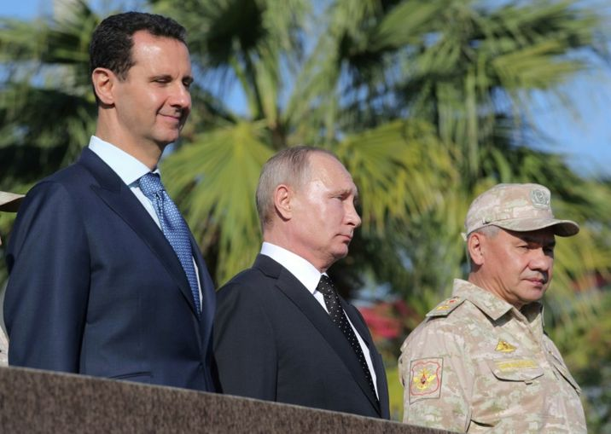
Principles of Proxy War
Principals, agents, and actors act in accordance with their respective political objectives.
Proxy relationships will expire; therefore it is imperative for principals to identy their own termination criteria and transition plan.
Because of ‘lag,’ tactical feedback should not be viewed as representative of operational, strategic, or political direction.
A principal’s continued presence beyond the end of the principal-agent relationship can cause the proxy’s political, social, and military entities to turn against its partner.
It is better to face one opponent than it is two; therefore, opponents will attempt to dislocate principal-agent relationships (akin to Napoleon’s strategy of central position).
Savvy opponents will dislocate the principal-agent relationship by:
Attacking the relationship’s bond (i.e. inducing problem of agency and problem of risk-sharing)
Introducing existential threats
Due to ‘lag’ and evolving relationship dynamics, red teams and assessments programs should have positions of power within headquarters and commands involved in proxy wars.

Slide 23
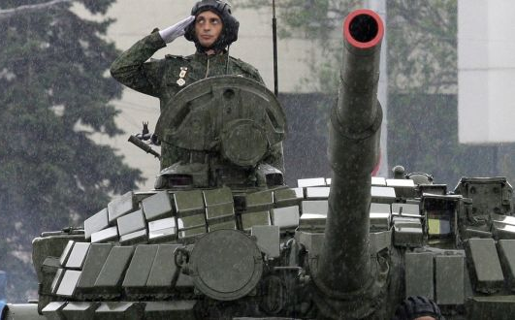
Conclusion
“Unless you understand the actual circumstances of war, its nature, and its relations to other things, you will not know the laws of war, or know how to direct war, or be able to win victory.”
- Mao Tse-tung Problems of Strategy in China’s Revolutionary War
Embrace proxyism:
- define proxy environments
- develop a theory of proxy war
- develop a doctrine for proxy warfare
Increase the role of assessments:
- monitor interests
- measure relationship
- assess influence of external actors
Purpose-built forces:
- Headquarters
- Tactical formations
Manning for purpose-build forces:
- Commanders & Deputy Commanders
- Strategists
- Operations Research and Systems Analysists (ORSAs)
- Intelligence Officers
- Dual-purposed officers and soldiers
- proxy specialists
Return to functional areas as broadening assignments

Slide 24
Further Reading and Contact Information
Amos C. Fox
Major, U.S. Army
Fort Carson, Colorado
Email:
amos.c.fox.mil@mail.mil
or
amos.c.fox@gmail.com
Phone:
(812) 592-3183
Conflict and the Need for a Theory of Proxy War
Journal of Strategic Security, Volume 12, No. 1 (2019)
Available at:
https://scholarcommons.usf.edu/jss/vol12/iss1/3
In Pursuit of a General Theory of Proxy Warfare
Institute of Land Warfare, Land Warfare Paper 123 (2019)
Available at:
https://www.ausa.org/publications/pursuit-general-theory-proxy-warfare
Time, Power, and Principal Agent Problems: Why the U.S. Army is Ill-Suited for Proxy Warfare Hotspots
Military Review, March-April 2019
Available at:
https://www.armyupress.army.mil/Portals/7/military-review/Archives/English/MA-2019/Fox-Proxy-Warfare.pdf

